Slide 1
Housing Search in Massachusetts Supplemented by Foursquare Venue Data
IBM Applied Data Science Capstone, Coursera
Chris Grace
May 21, 2021

Slide 2
Introduction
In the search for a new home it is easy to filter homes by things such as price, sq footage, or bedrooms using popular website such as Zillow, Realtor, or Redfin.
However, that is only half the story. The neighborhood and the amenities around the house are also important.
This project combines Redfin data with Foursquare data to satisfy house attributes as well as neighborhood amenity requirements.

Slide 3
Purpose
Clients approached our real estate office to help with their property search. They need a larger house for a growing family but like the amenities in their neighborhood.
They were spending a lot of time researching each neighborhood they found a suitable house for sale.
Developing this code to help them as well as future clients with similar needs.
Can be used as a marketing differentiator.

Slide 4
Requirements
House Requirements
Neighborhood Requirements
Max Price: $800,000
Min Price: $649,000
Max sqft: 3,500
Min sqft: 2,000
Min Beds: 3
County: Essex, Massachusetts
Single Family Home
Amenity | Distance | Amenity | Distance
Park | 0.5 miles | Train Station | 2 miles
Grocery Store | 2 miles | Golf Course | 4 miles
Fire Station | 2 miles | Emergency Room | 5 miles
Police Station | 2 miles

Slide 5
Data
Redfin API
Allows up to 350 houses to be returned in a CSV file based on requested criteria.
Foursquare API
Many request options available, we will leverage the venue search function
Allows venues based on a specific category to be returned for a specific geolocation.
Data will be processed using python code from within a Jupyter Notebook

Slide 6
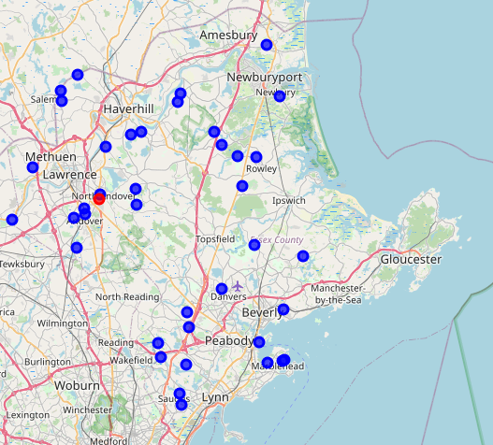
Methodology
Define current residence and geolocation
201 Andover ST, N. Andover
Retrieve Redfin data from API
Returned 39 properties
Red = Current Residence
Blue = For Sale Home

Slide 7
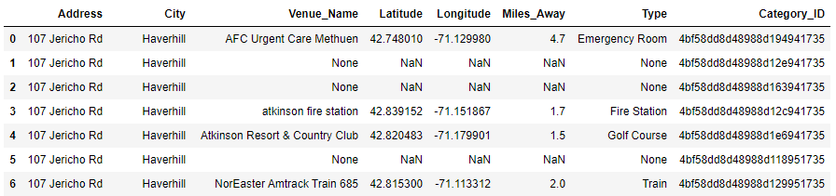
Sample of Returned Amenities
This house at 107 Jericho Rd only met 4 of the 7 required amenities.
It is not a suitable property per the requirements.

Slide 8
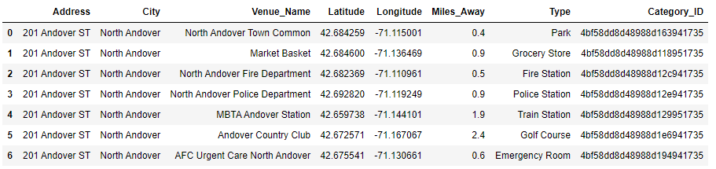
Comparison to Current Residence
Current residence meets all amenity requirements.
However, as stated previously, the house is too small

Slide 9
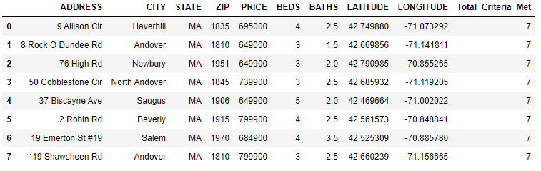
Combine Redfin and Filtered Foursquare Data
These are the 8 properties out of the original 39 which meet all client criteria.

Slide 10
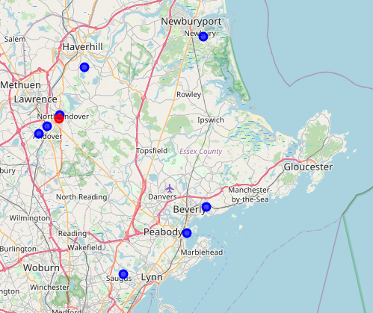
Final Property List and Map
9 Allison Cir, Haverhill
18 Rock O Dundee Rd, Andover
276 High Rd, Newbury
350 Cobblestone Cir, N. Andover
437 Biscayne Ave, Saugus
52 Robin Rd, Beverly
619 Emerton St #19, Salem
7119 Shawsheen Rd, Andover

Slide 11
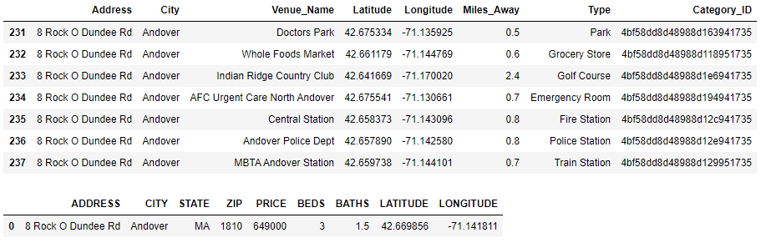
Explore Individual Properties
Jupyter Notebook is coded to allow each house to be viewed individually. This is an example of the results for 8 Rock O Dundee Rd:

Slide 12
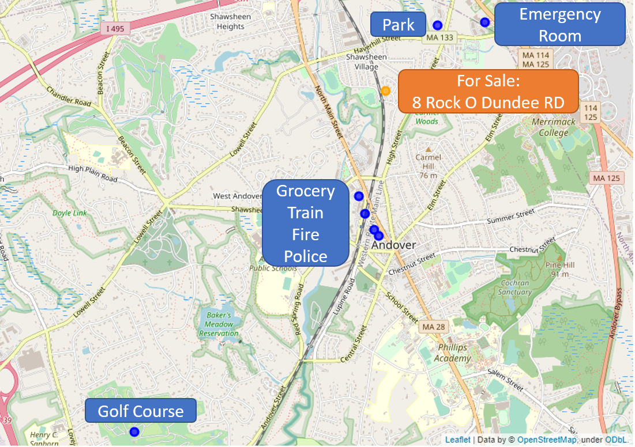
Explore Individual Properties
Neighborhood of:
8 Rock O Dundee Rd

Slide 13
Discussion
Difficulties encountered:
Redfin API not officially supported
Foursquare API:
Has some venues miscategorized
Query limit on free unverified version is only 950 per day
Suggestions:
Final deliverable to view neighborhood maps is within Jupyter Notebook which does not make it easily accessible. Suggest putting it in a more user friendly dashboard such as on Tableau Public.

Slide 14
Conclusion
This project was able to achieve its goal of cutting down on the arduous search process and reducing the number of houses to explore in this example from 39 down to only 8.
Of that 8 houses that need to be explored further, the neighborhoods are all mapped out with the required amenities for easy comparison.
This will significantly reduce the burden for our clients in their search for suitable homes.

